Slide 1

Northern Arizona University Turbine Design
Lucas Duncan
Calum Eikenberry
Nigel Grey
Ethan Maltaverne
Daniel Massaglia
Marina McCue
Matthew Mennell
Sean Veden
Sean

Slide 2

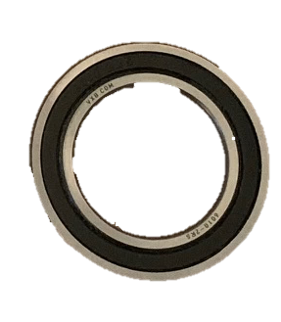
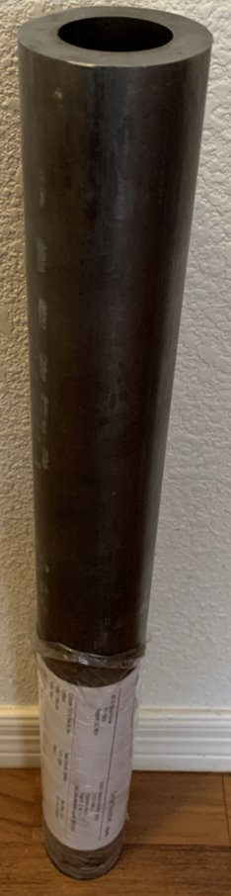
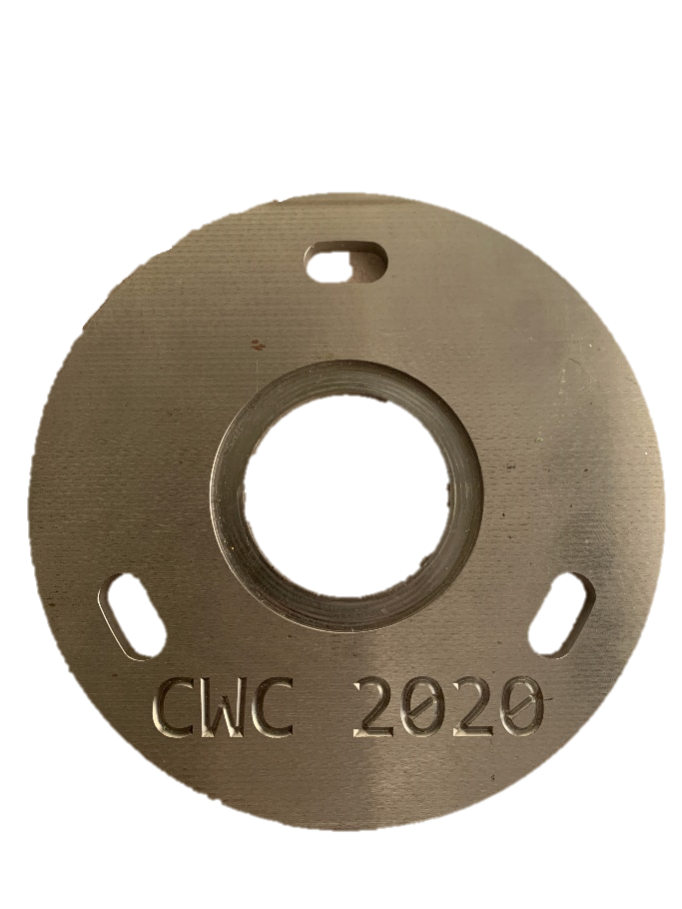
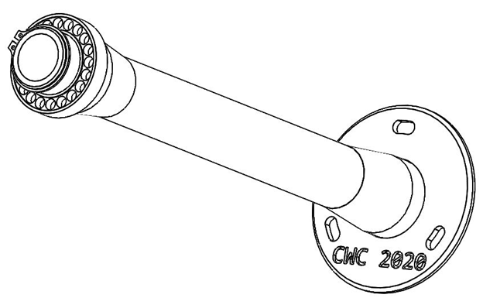
Tower: Base Plate: Yaw Bearing: Retaining Ring
Retaining Ring
Tower
Baseplate
Bearing
Daniel

Slide 3
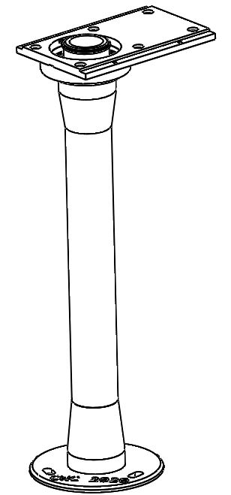
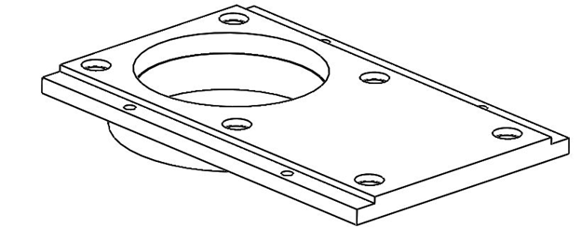
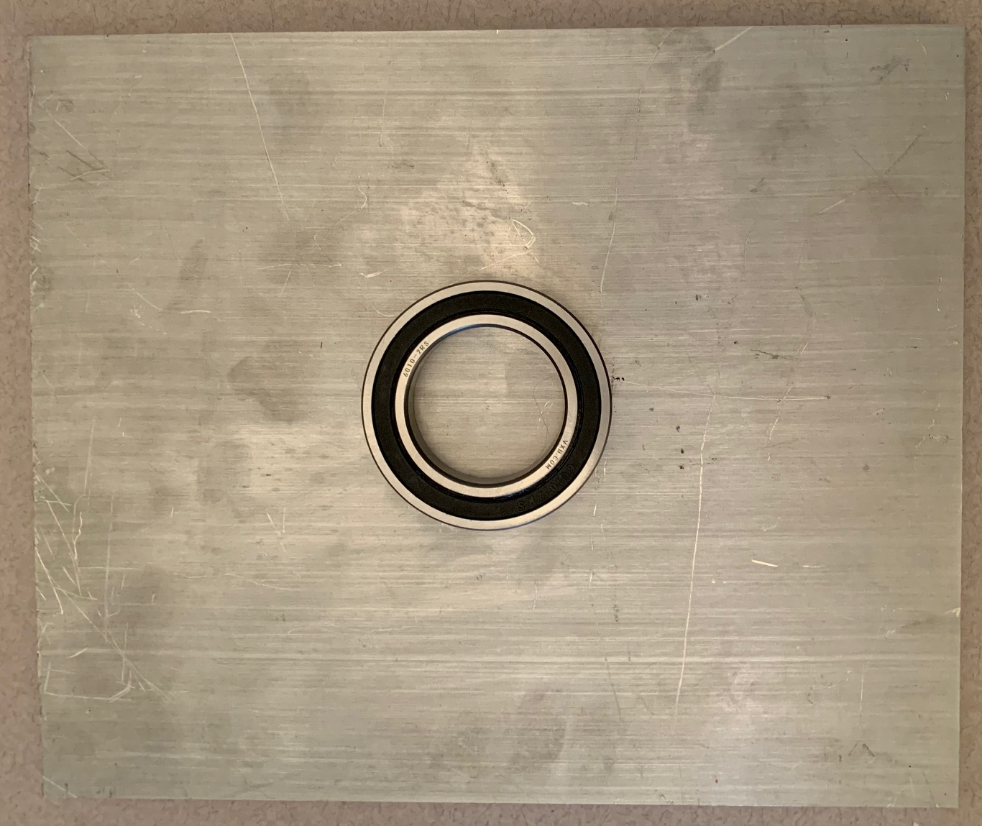
Lower Nacelle Plate
Yaw Sliding rails
Lower Nacelle Plate
Tower Bearing
Tower Assembly
Matt
Notes:
The lower nacelle plate is manufactured from aluminum, this plate is pressed into the tower bearing to support the nacelle and yaw without restricting rotation

Slide 4
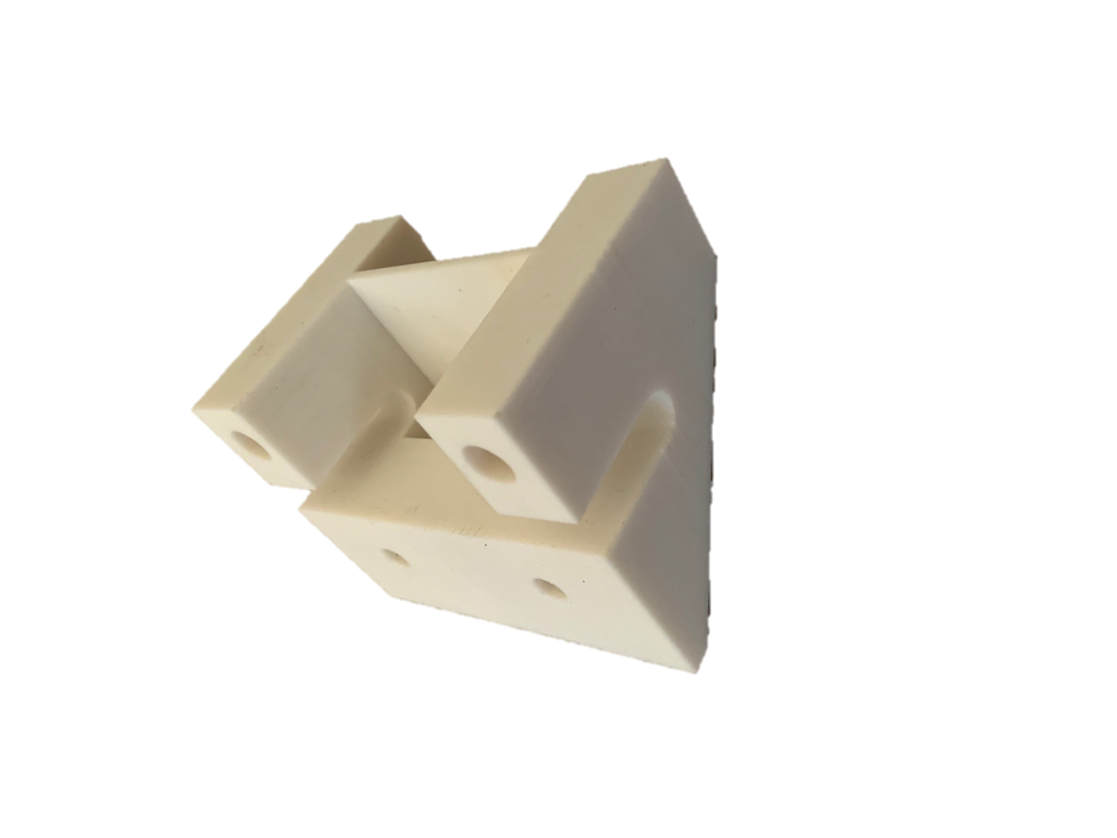
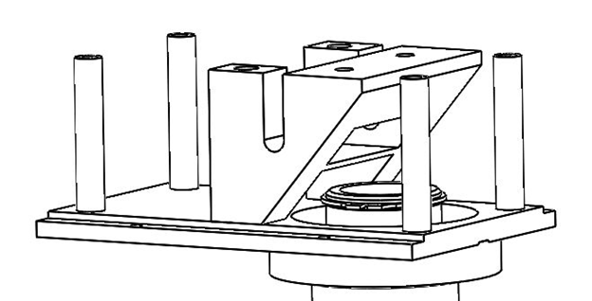
Nacelle Spacing/ Disc Housing
Mid Nacelle Standoff
Matt
Notes:
The Nacelle Spacer along with standoffs help support two separate top nacelle plates. This lets the disc for the brakes sit in a lower position

Slide 5
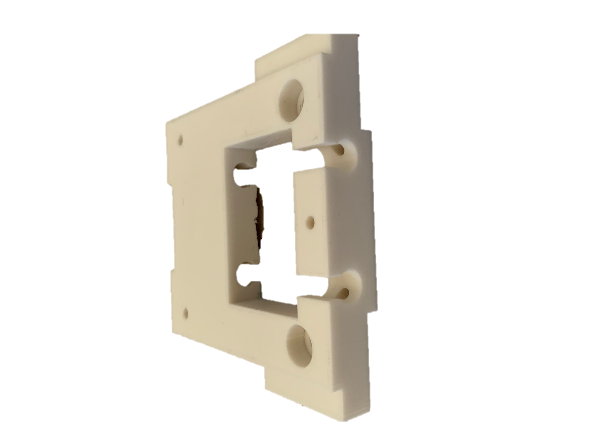
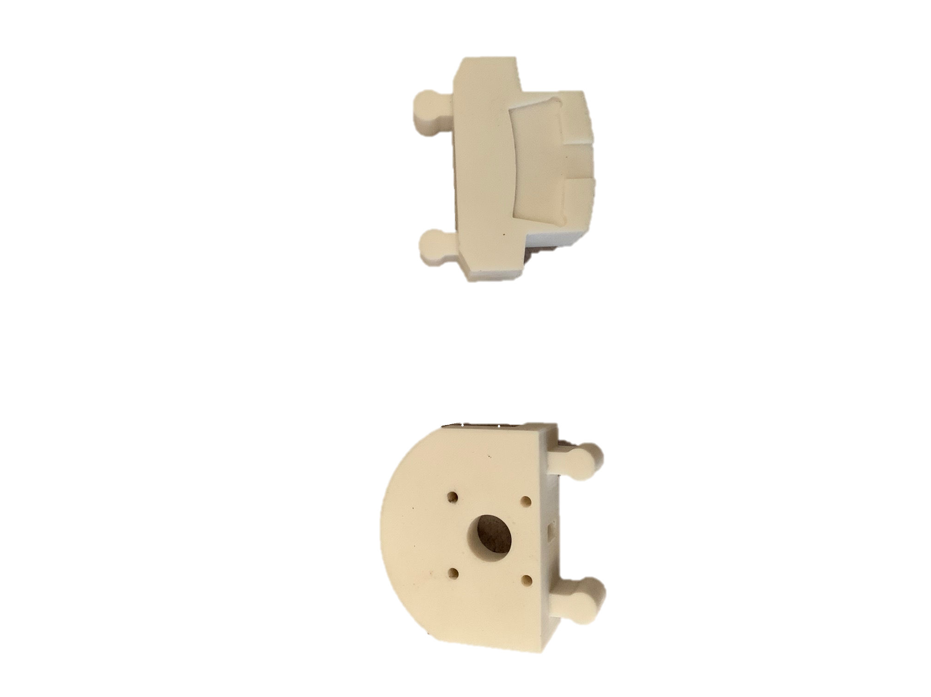
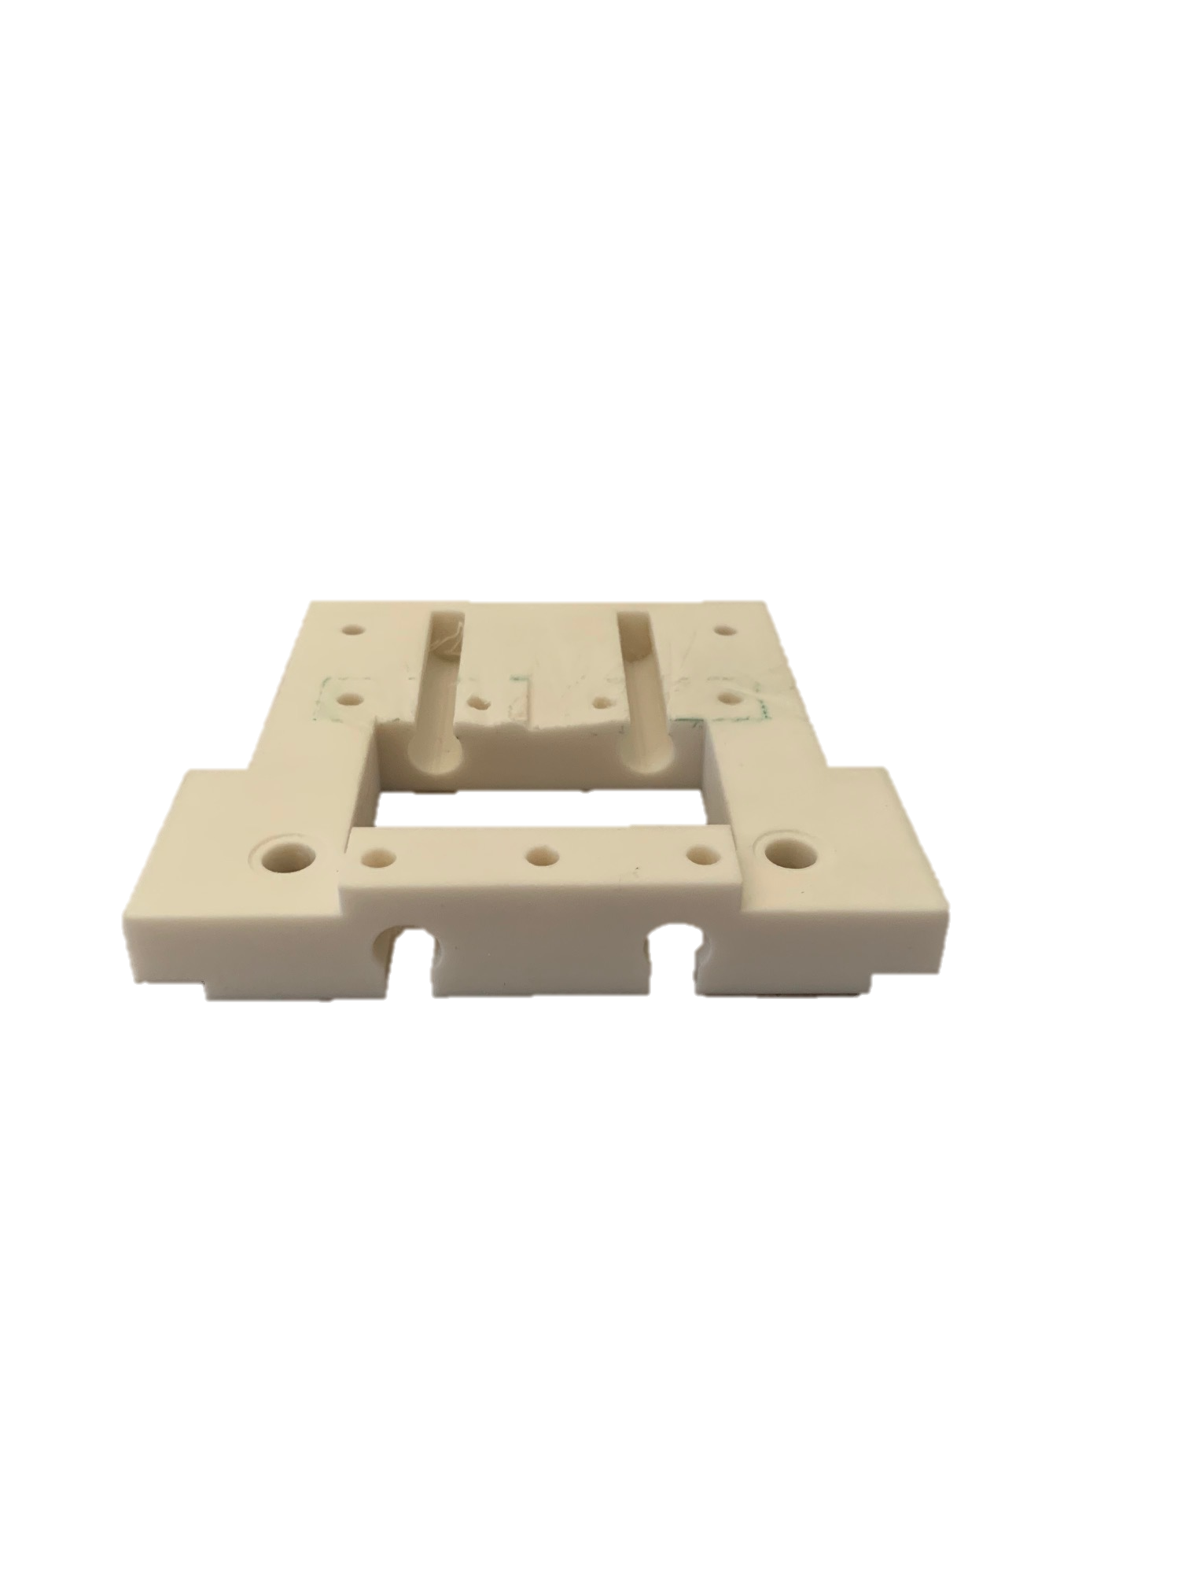
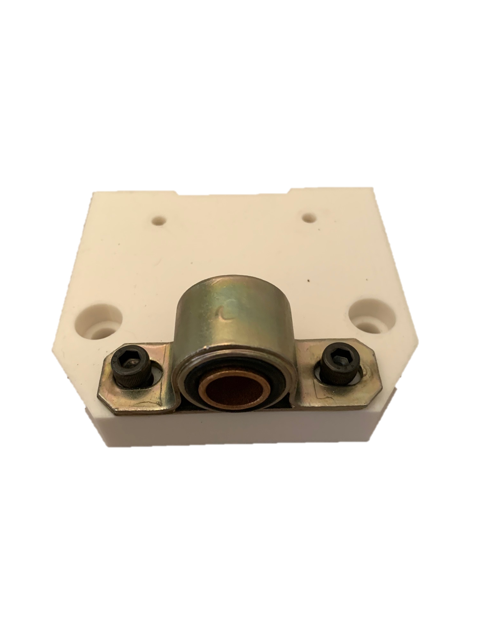
Upper Nacelle Components
Sliding rails
Rail Receiver
Brake Pad Slot
Brake Slider
Top Nacelle Plate (Back)
Motor rails
Mounting Holes
Motor Mount
Top Nacelle Plate (Front)
Ethan

Slide 6
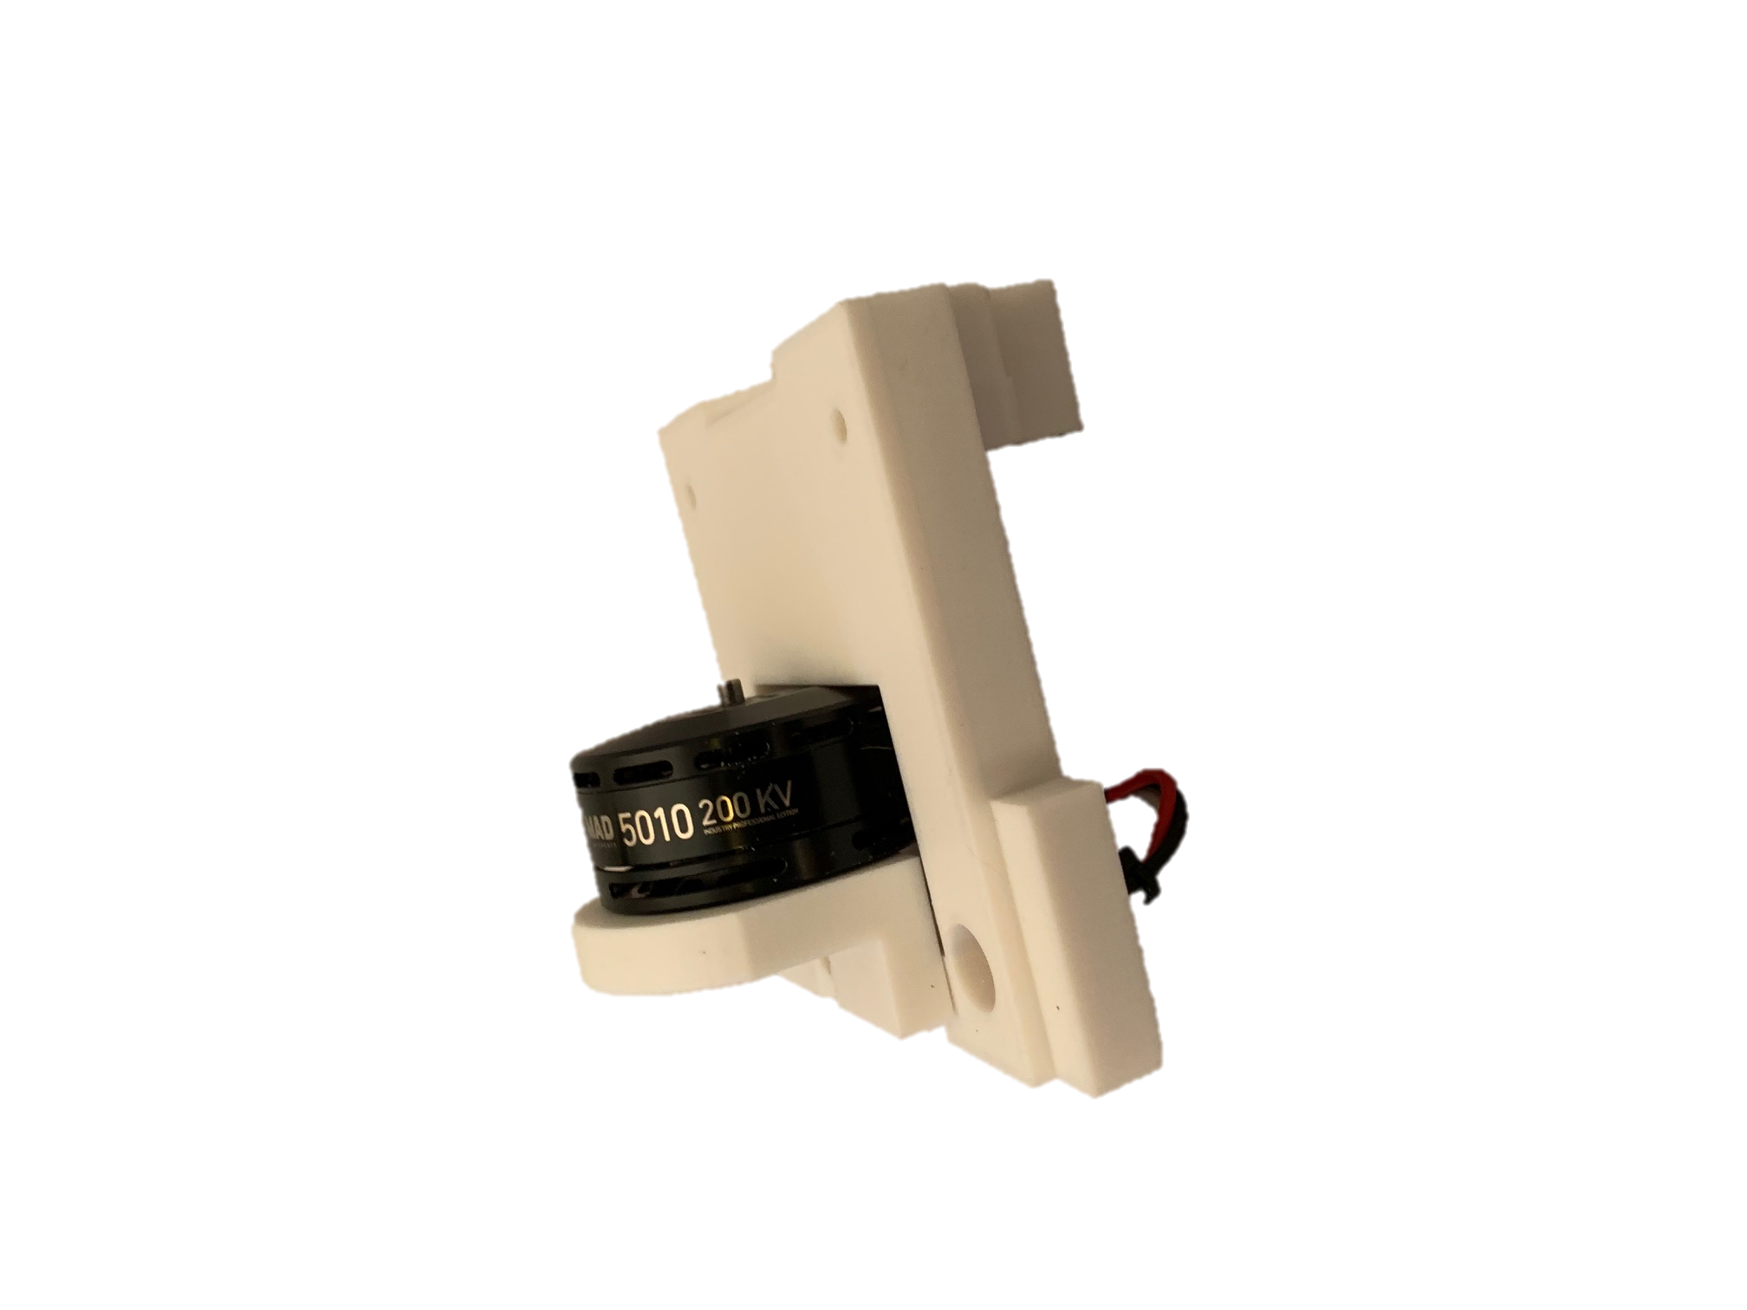
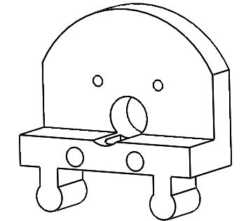
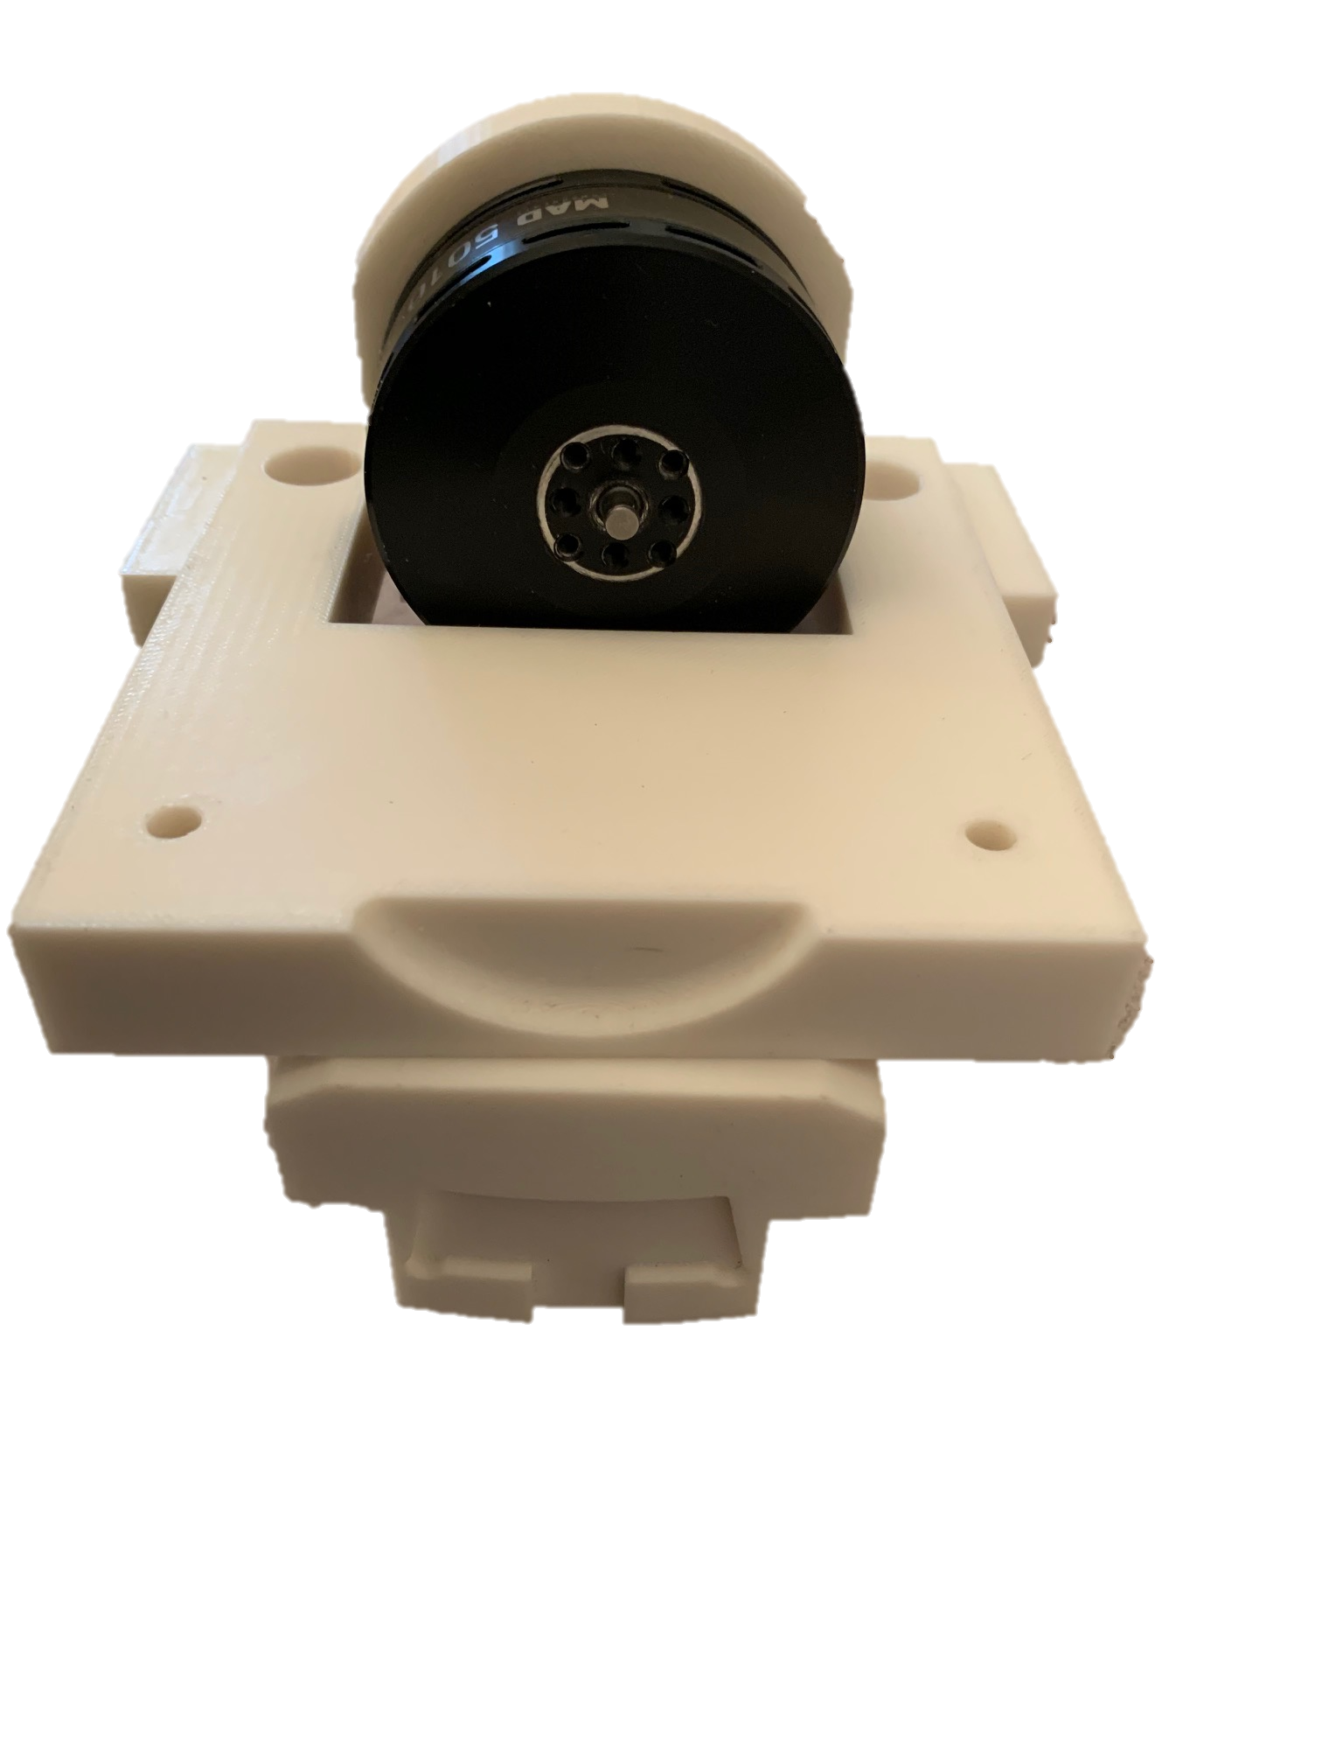
Generator Mount \ Brake Pad Slider
Generator Slider
Brake Slider
Ethan

Slide 7
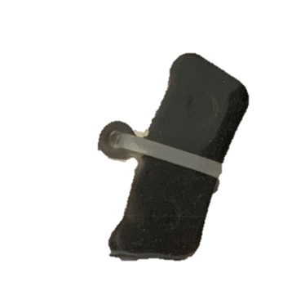
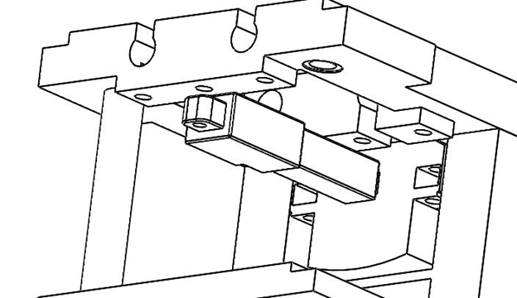
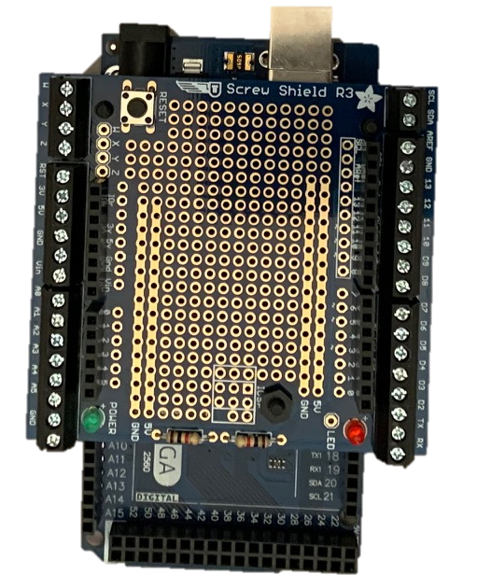
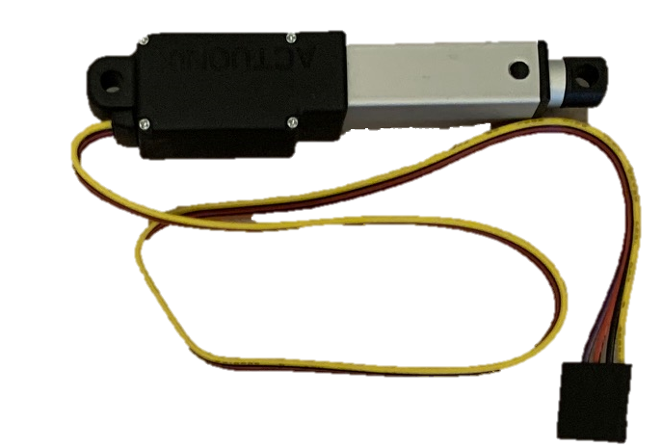
Braking System
Brake Slider
Semi-metallic Brake Pad
Brake Assembly
80N Actuator
Proto Wing Shield on an Arduino Mega
Sean

Slide 8
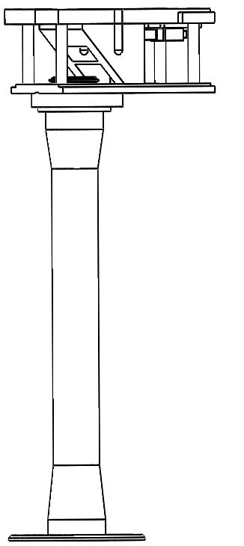
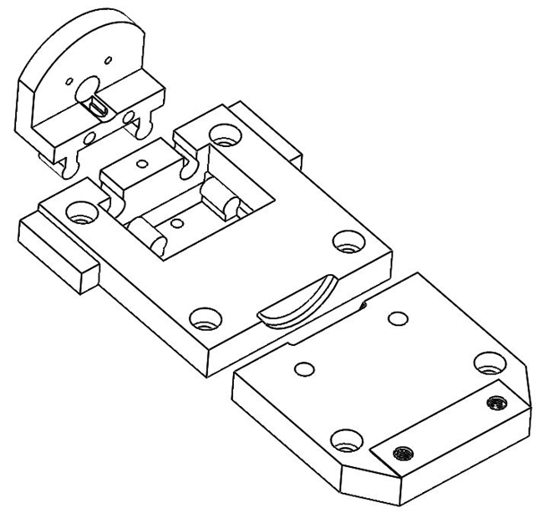
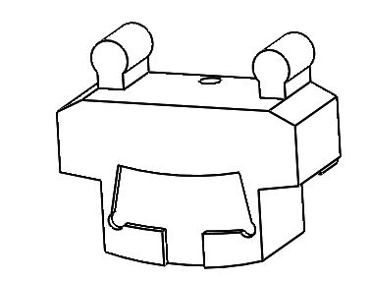
Upper Nacelle Assembly
Generator Mounting
Braking Slider
Front
Lucas

Slide 9
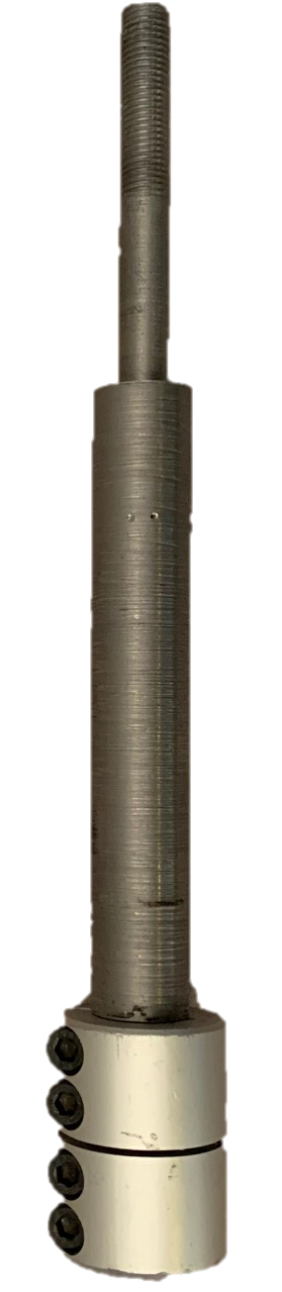
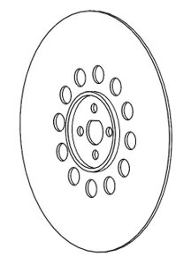
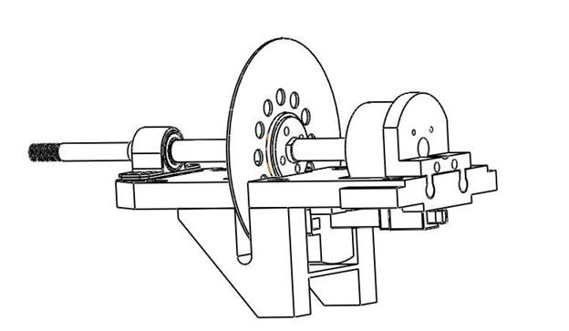
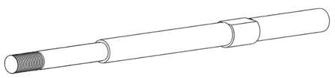
Shaft Assembly
Brake Disk
Upper Nacelle Assembly
Axle/ Drive Shaft
Lucas

Slide 10
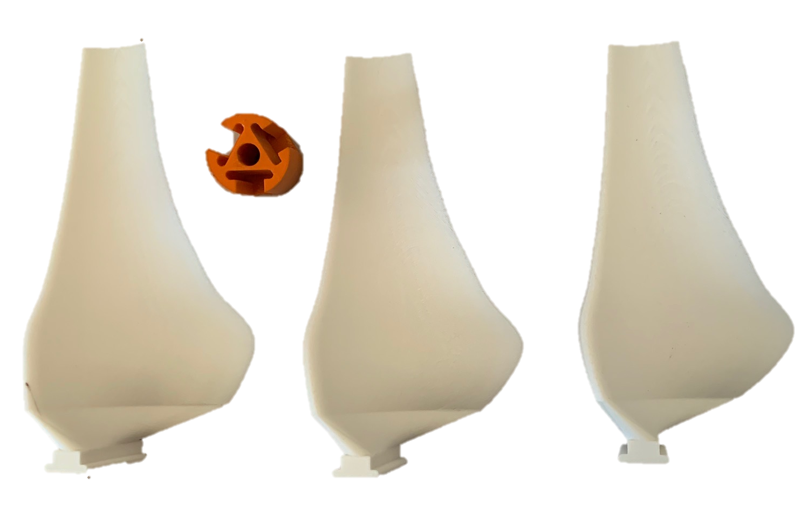
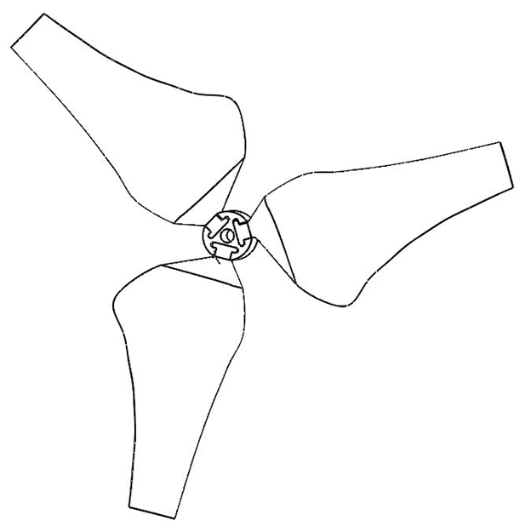
Hub and Blades
Marina

Slide 11
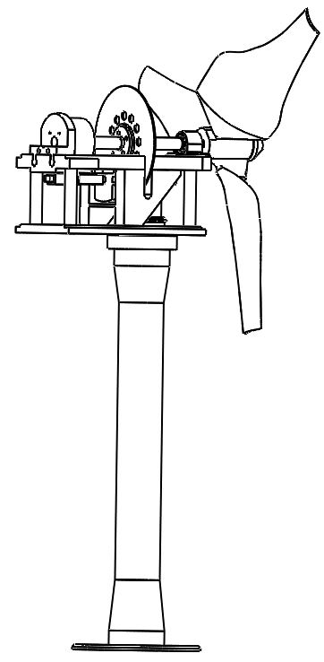
Marina

Slide 12
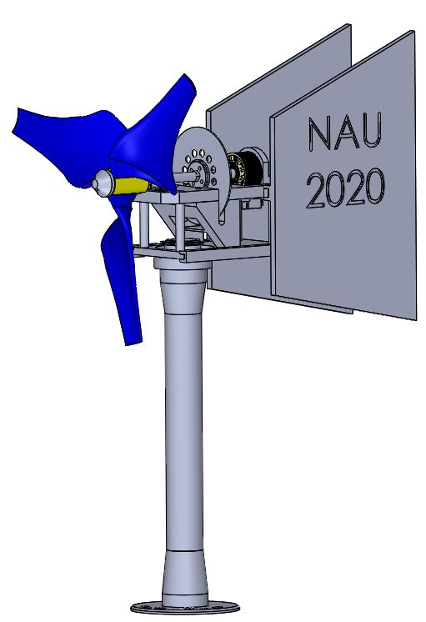
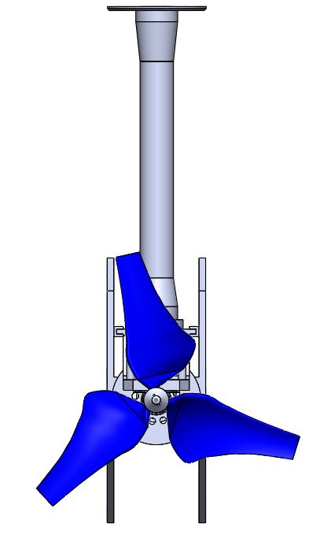
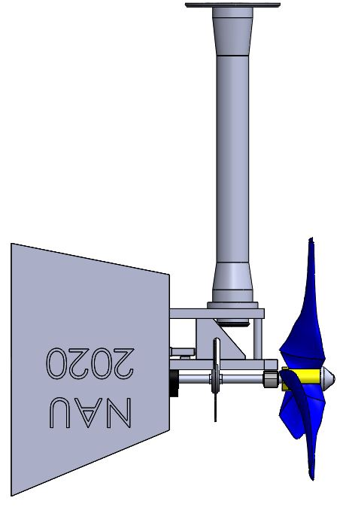
Yaw
Lucas

